Slide 1

FY27 Appropriations Guide
How to complete the GPSA appropriation request form
GPSA Finance • 2026–2027
Notes:
Open by explaining that this deck focuses on helping CSOs fill the Appropriation Request sheet correctly.

Slide 2
Start with the right mindset
2026–2027
Goal
A complete request is clear, documented, and easy for Finance Committee to review.
Be specific — what, when, where, why, how much, and who benefits.
Use the correct area — travel in Travel Breakdown; events in Event Breakdown; general items in Services/Equipment/Supplies.
Attach quotes separately — do not paste quotations into the Excel workbook.
Keep line descriptions short — the detail rows have character limits.
Fill the CSO sections only.
Blue “Finance Committee Use Only” areas are not for applicants.
GPSA Finance • FY27 Appropriations Tutorial • 2
Not a substitute for Standing Rules, SGAO, or Council approval.

Slide 3
At-a-glance workflow
2026–2027
Download form
Fill org info
Add request details
Attach quotes
Email package
Complete sections in order so the summary and required-quote logic work correctly.
Before submission: Excel form + separate quotation files, with clear filenames.
GPSA Finance • FY27 Appropriations Tutorial • 3
Not a substitute for Standing Rules, SGAO, or Council approval.

Slide 4
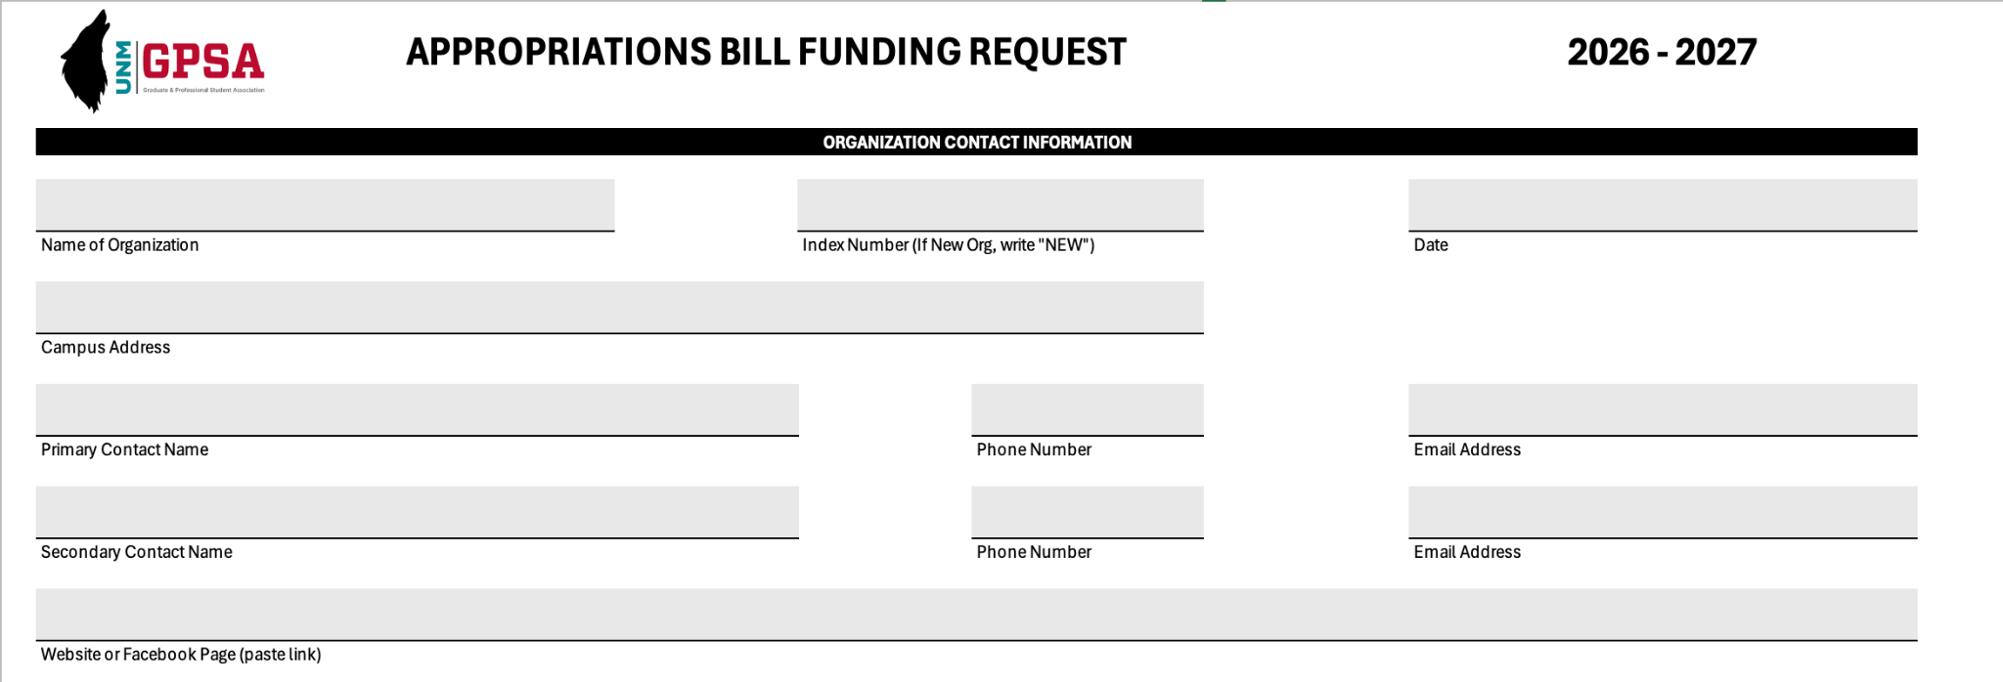
Organization contact information
2026–2027
Every box matters
This is the first place reviewers check for completeness.
CSO name — write the full name with abbreviation, e.g., Graduate and Professional Student Association (GPSA).
Index number — new CSOs write “NEW”; existing CSOs use the FY27 Index List or contact SGAO.
Campus address — use your campus office address or write University of New Mexico.
Contacts — use full names, phone format (XXX) XXX-XXXX, and UNM email addresses.
Website/social media — include a website or official social media link if available.
Top section of the new FY27 form
FY27 Index List
or contact SGAO if you cannot confirm your index number.
GPSA Finance • FY27 Appropriations Tutorial • 4
Not a substitute for Standing Rules, SGAO, or Council approval.

Slide 5
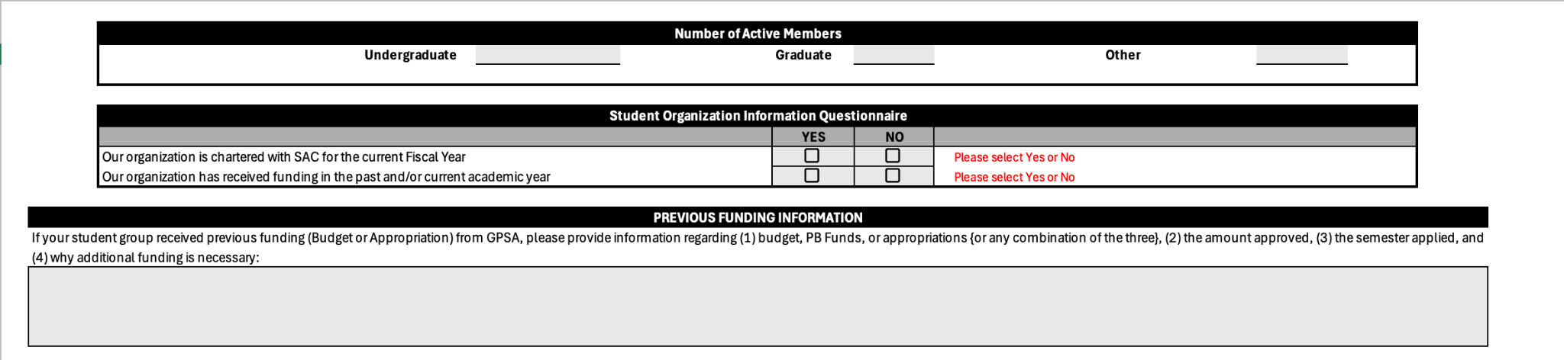
Active members, questionnaire, and prior funding
2026–2027
Do not confuse members with attendees
This section explains the organization, not the event turnout.
Active members — count the core or executive members associated with the group.
Attendees — event participants belong in event/travel sections, not active members.
Checkboxes — select Yes or No for every required question.
Prior funding — briefly list funding type, amount, semester/year, and why more funding is needed now.
Keep it short — this section should not become a long paragraph.
Member counts and previous funding section
Previous funding can be Annual Budget, PB Funds, Appropriation, or a combination.
GPSA Finance • FY27 Appropriations Tutorial • 5
Not a substitute for Standing Rules, SGAO, or Council approval.

Slide 6
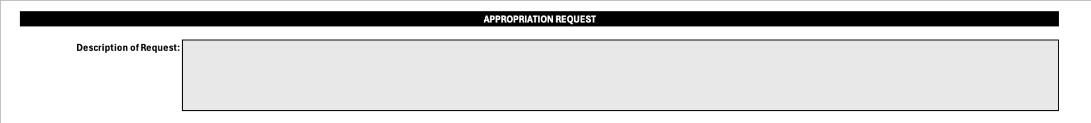
The main Appropriation Request box
2026–2027
Tell the full story here
This box does not have a character limit.
What — the program, trip, event, item, or service being requested.
When — dates or expected timing.
Where — event location, conference location, or campus use location.
Why — how this supports graduate and professional students.
How — how funds will be used and how many students will benefit.
Main narrative box
Use this space for details. Later category rows have short character limits.
A strong request answers what, when, where, why, who benefits, and how much.
GPSA Finance • FY27 Appropriations Tutorial • 6
Not a substitute for Standing Rules, SGAO, or Council approval.

Slide 7
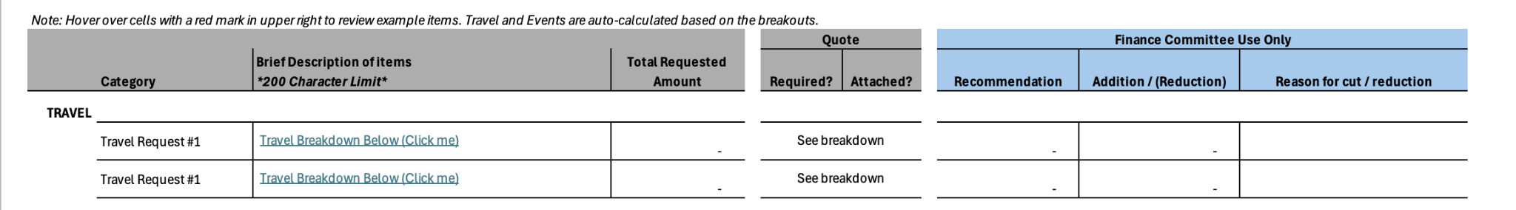
Main request table: use the links, not manual typing
2026–2027
Important
Travel and event totals are auto-calculated from the breakdown areas.
Travel — click “Travel Breakdown Below (Click me)” for Travel Request #1 or #2.
Events — click the event breakdown link for Event Request #1, #2, or #3.
Other requests — use the Services, Equipment, Supplies, or Miscellaneous sections below.
CSO area only — do not fill Finance Committee recommendations, reductions, or reasons.
Summary and breakdown links
If the form shows “See breakdown,” complete the linked section below.
If a formula is not updating, check whether the linked breakdown section is complete.
GPSA Finance • FY27 Appropriations Tutorial • 7
Not a substitute for Standing Rules, SGAO, or Council approval.

Slide 8
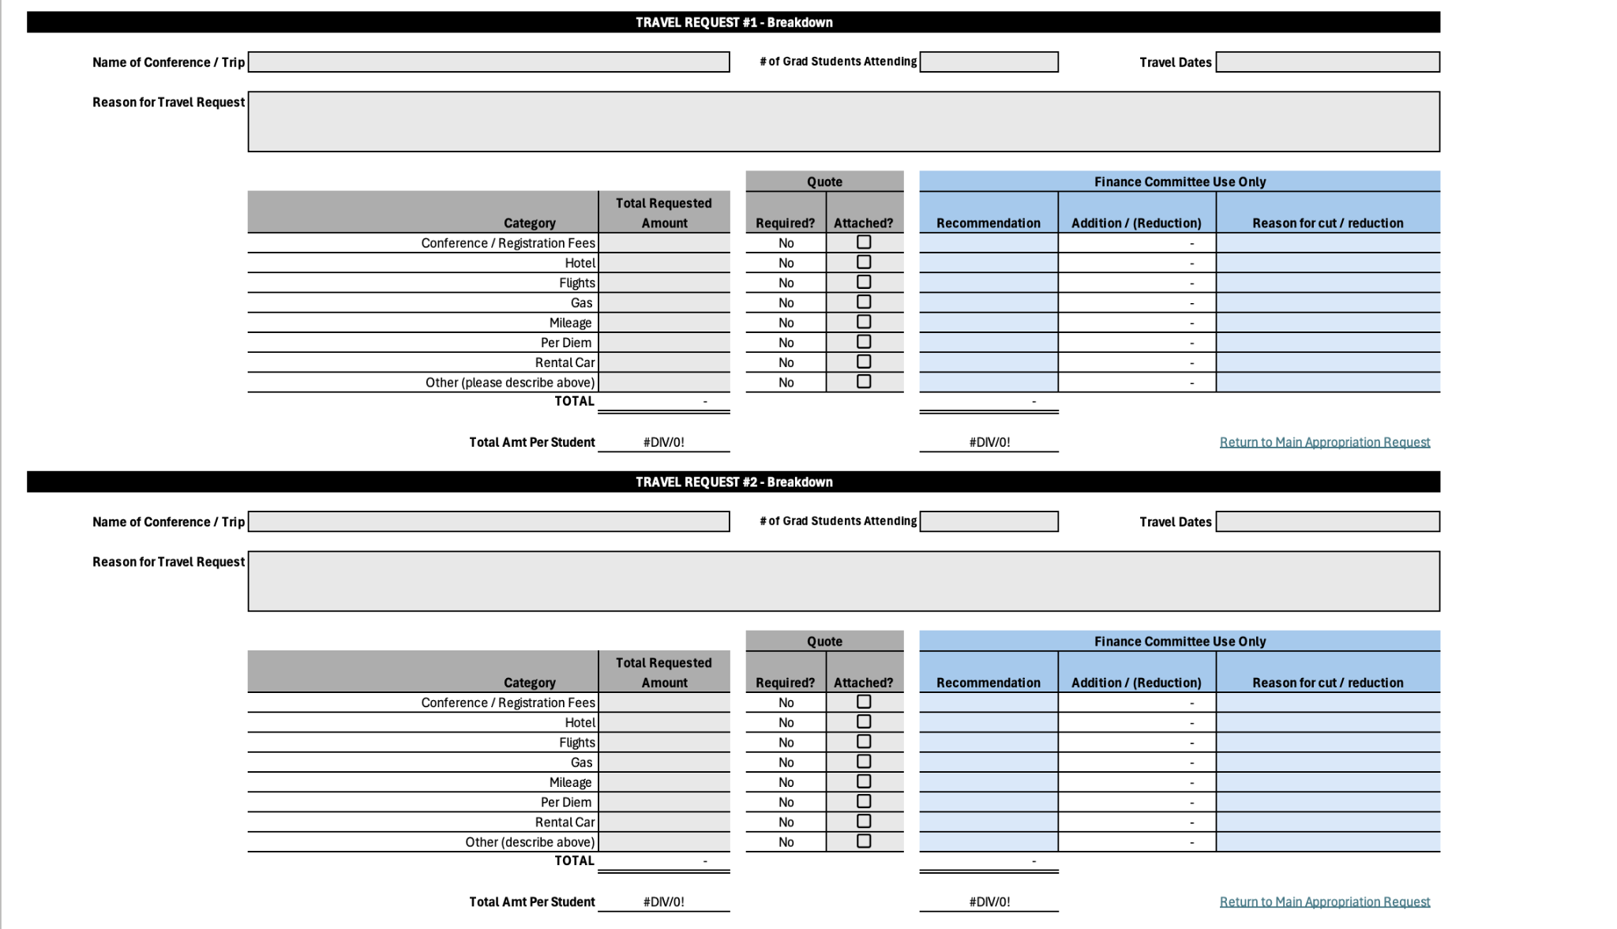
Travel requests: complete the travel breakdown
2026–2027
Travel Request #1 and #2
Use one travel breakdown per conference/trip.
Top fields — full conference/trip name, number of graduate students attending, and travel dates.
Reason box — briefly explain the conference and why your CSO should attend.
Amounts — enter the total amount needed by section—not per student.
Quotes — the form will show when a quote is required; attach it and check the box.
Second trip — use Travel Request #2 only if you are requesting another trip.
GPSA Finance • FY27 Appropriations Tutorial • 8
Not a substitute for Standing Rules, SGAO, or Council approval.

Slide 9
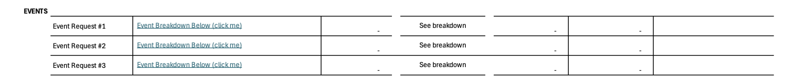
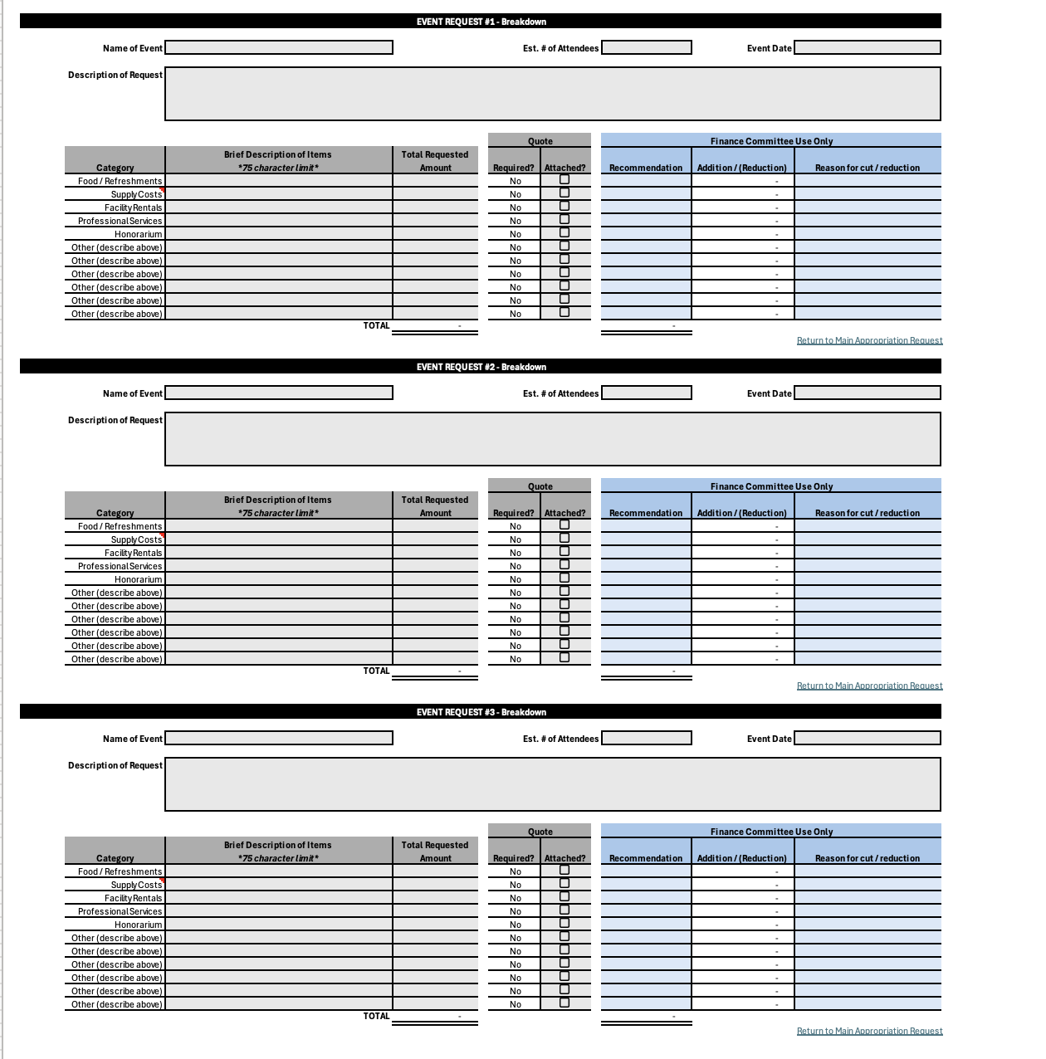
Event requests: complete each event separately
2026–2027
Event Request #1–#3
Use separate event sections for separate events.
Event details — include full event name, expected attendees, and event date.
Description — briefly explain what, when, where, how, and why you are organizing it.
Category rows — write only a few words because the item description has a character limit.
Missing category — use “Other (describe above)” and clearly name the category in the description.
Multiple events — use Event #2 and Event #3 when needed.
Event links in the main table
Event breakdown sections
GPSA Finance • FY27 Appropriations Tutorial • 9
Not a substitute for Standing Rules, SGAO, or Council approval.

Slide 10
Category rows: keep each line item separate
2026–2027
Write one clear line per request
This avoids confusion during review.
Food — food/refreshments for a specific event or meeting.
Supplies — items needed to run the event or activity.
Facility rentals — room, venue, or facility charges.
Professional services — services such as DJ, speaker system, or contracted support.
Other — use only when no listed category fits; describe it clearly.
Same category can appear again only when it belongs to a different event or eligible section.
GPSA Finance • FY27 Appropriations Tutorial • 10
Not a substitute for Standing Rules, SGAO, or Council approval.

Slide 11
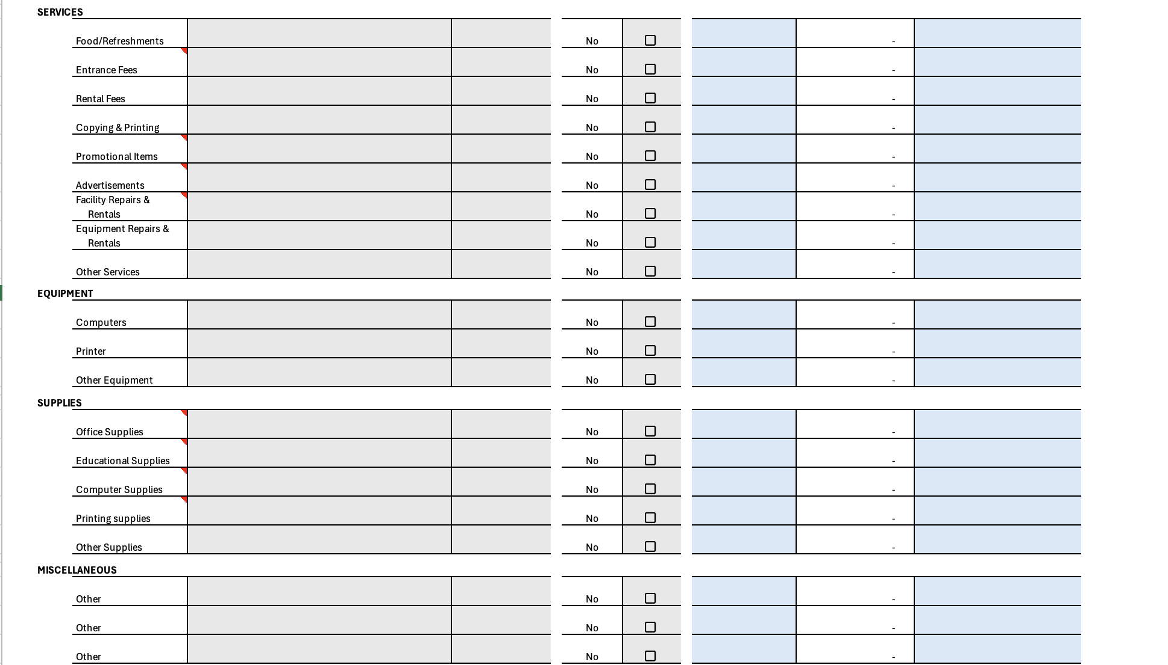
Non-event requests: use Services, Equipment, Supplies, or Miscellaneous
2026–2027
For general CSO needs
Use these sections when the request is not tied to a specific event or travel.
Services — food, entrance fees, rental fees, copying/printing, advertising, repairs, other services.
Equipment — computers, printers, or other equipment.
Supplies — office, educational, computer, printing, or other supplies.
Miscellaneous — use only when nothing else fits.
Red corner notes — hover over cells with red markers to see examples.
General request categories below the event sections
GPSA Finance • FY27 Appropriations Tutorial • 11
Not a substitute for Standing Rules, SGAO, or Council approval.

Slide 12
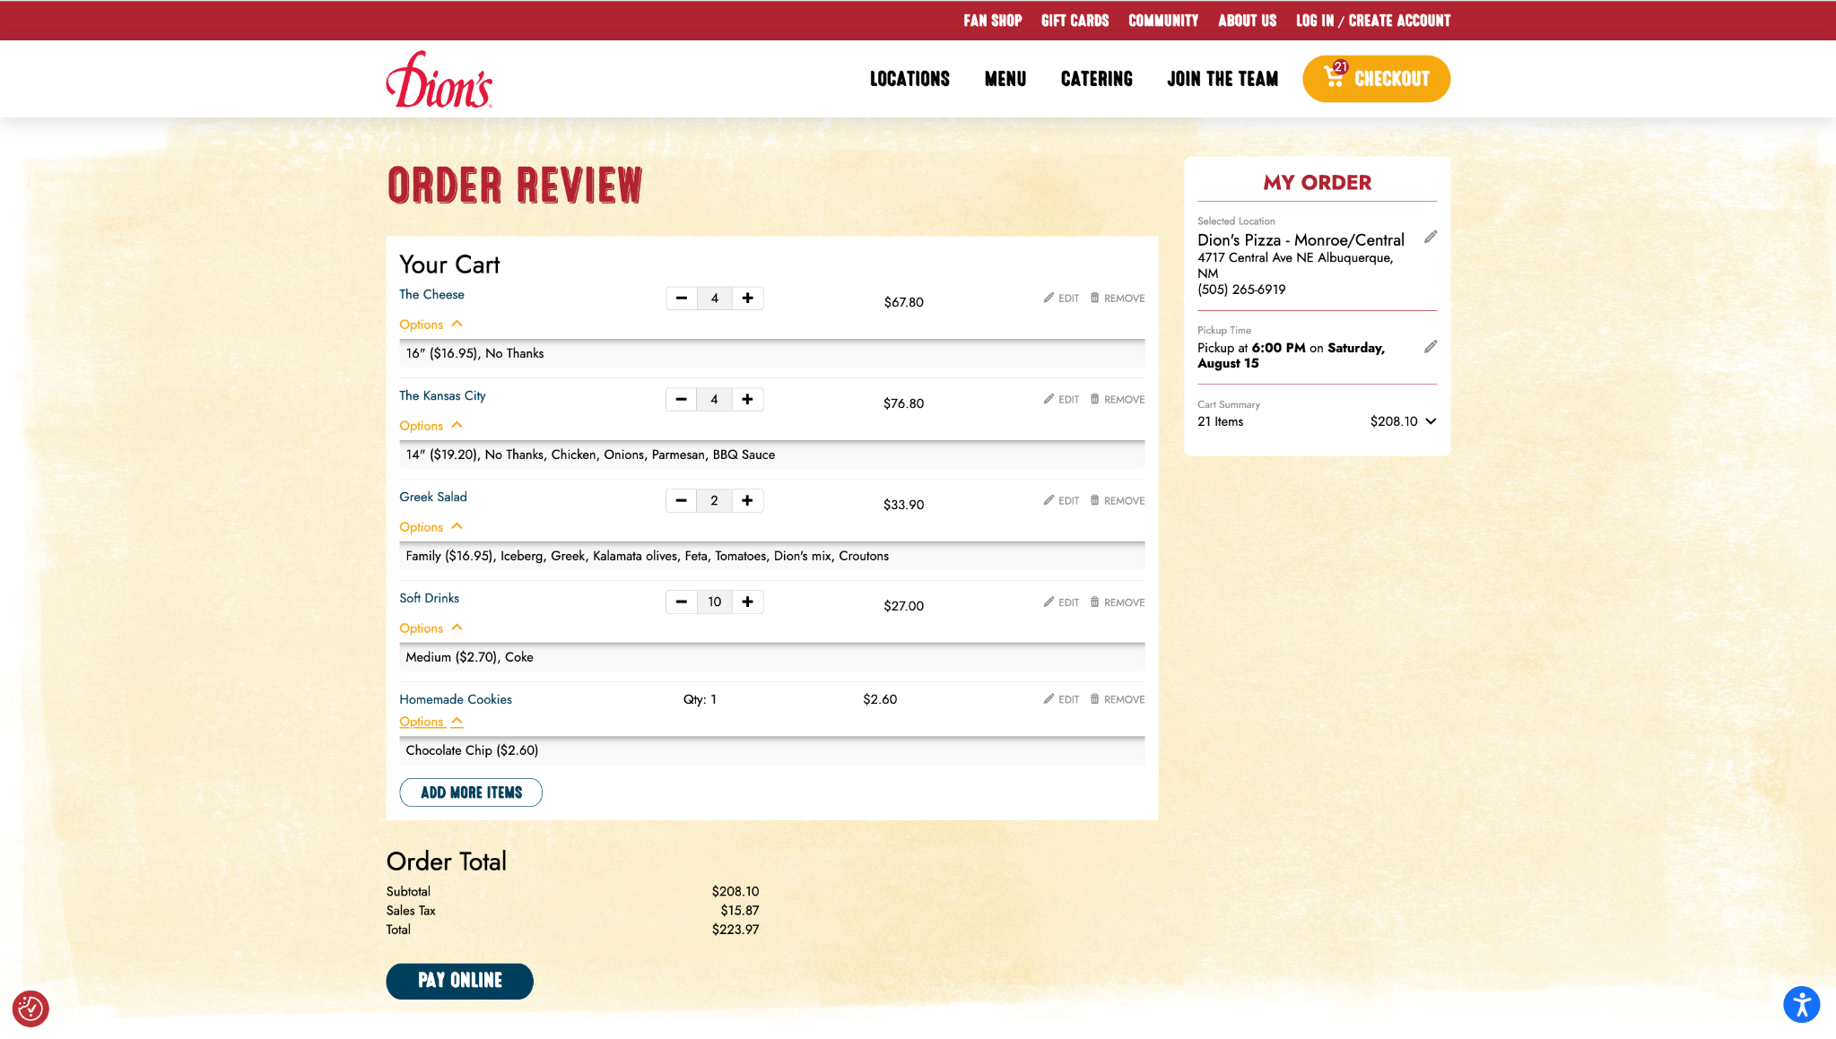
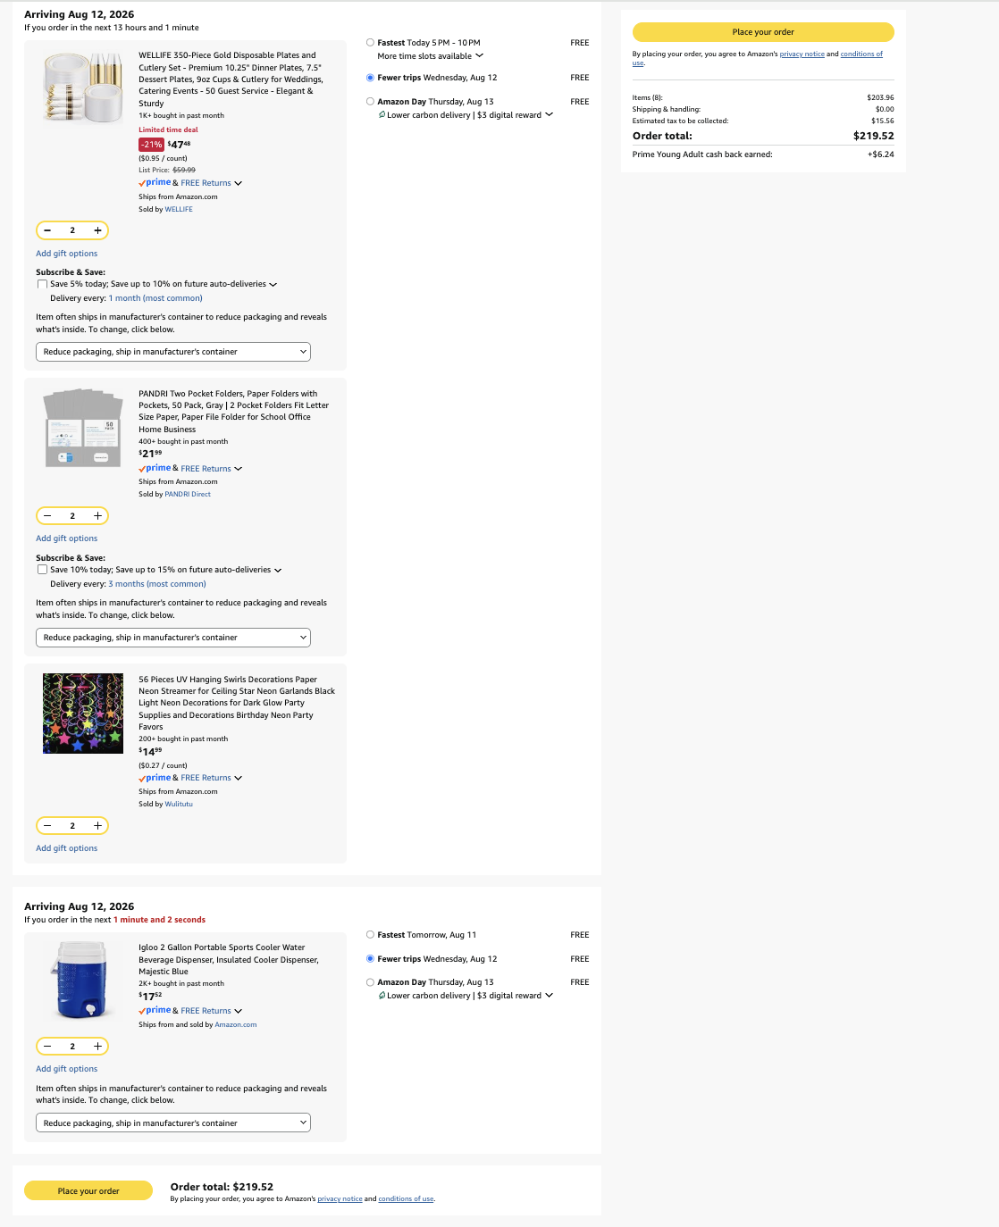
Quotation basics
2026–2027
What counts as a quote?
A quote should make the requested amount easy to verify.
Required threshold — quote is required for any line-item request over $200.
Accepted formats — PNG, JPG, or PDF.
Must show — item name, quantity, price, and total including tax when applicable.
Do not paste — quotation files should be separate from the Excel form.
Do not combine — submit separate quote files for separate categories or line items.
Food quote example
Shopping cart example
If a restaurant order totals $223.97, request $223.97—not just the subtotal.
One category = one clear quote whenever possible.
GPSA Finance • FY27 Appropriations Tutorial • 12
Not a substitute for Standing Rules, SGAO, or Council approval.

Slide 13
Food quotation example
2026–2027
Restaurant orders
Ask vendors for an itemized quotation when possible.
Use the total — include tax and fees in the requested amount.
Itemized is best — the committee should see what food/drinks are included.
Match the form — the quote amount should match the line-item total.
Keep separate — do not combine food quotes with supplies or promotional items.
In this example, the request amount would be $223.97.
GPSA Finance • FY27 Appropriations Tutorial • 13
Not a substitute for Standing Rules, SGAO, or Council approval.

Slide 14
Shopping cart quotations
2026–2027
Amazon or other online carts
Keep categories clean and easy to evaluate.
Show the cart total — include tax/fees when shown.
Show quantity — the screenshot should display how many of each item.
Separate categories — do not mix drinks, computer items, decorations, and utensils in one quote.
Match line items — each quote should clearly support the category requested.
In this example, the request amount would be $219.52.
GPSA Finance • FY27 Appropriations Tutorial • 14
Not a substitute for Standing Rules, SGAO, or Council approval.

Slide 15
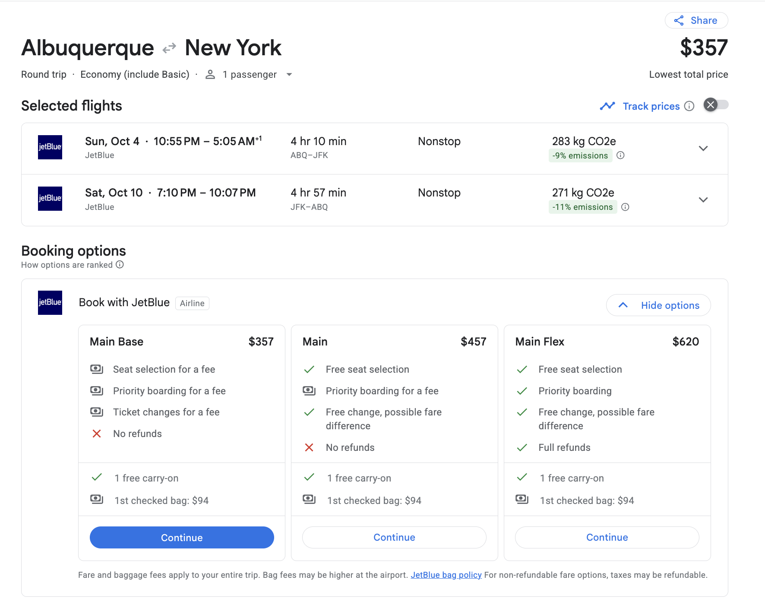
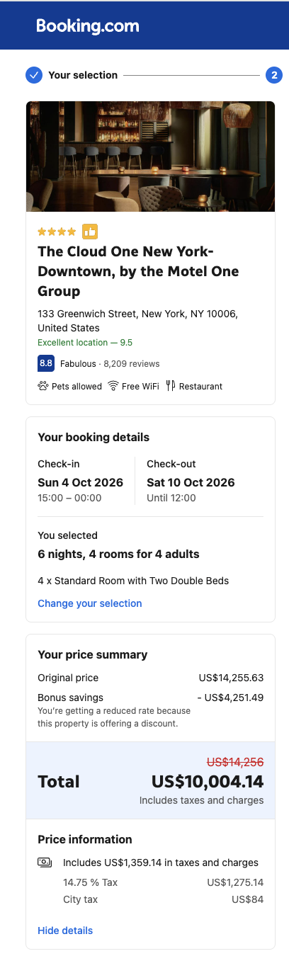
Travel quotations: airfare and hotel
2026–2027
Travel documentation
Make it clear how the total was calculated.
Airfare — provide three unique competitive quotes; request economy-class travel.
Per student — attach airfare quotes that show cost per graduate student.
Hotel — show dates, number of rooms, number of people, and final total.
Conference fees — attach registration fee information or invoice.
Travel breakdown — enter the whole section amount in the form.
Airfare quote example
For airfare, the form/reviewer should understand the quote per student and total number of students.
Hotel quote example
GPSA Finance • FY27 Appropriations Tutorial • 15
Not a substitute for Standing Rules, SGAO, or Council approval.

Slide 16
Useful caps and limits to remember
2026–2027
Quick reference
Quick caps
Food — large event
Food — small event
Food — GBM
Advertising
Copying / printing
Conference fees
Travel per diem
Airfare
Other unlisted items
Up to $1,500 per large event (100+ attendees), up to 2 events/semester
Up to $500 per small event (<100 attendees), up to 2 events/semester
Up to $150 per general body meeting, max 4 meetings/semester
Up to $150
Up to $200
Up to $900/org and $300/student
Up to $85/person/day; org max $1,800/conference
Up to 75% economy fare; max $500/student; 3 quotes required; org max $3,000/conference
Maximum 70% of quoted price, subject to FC/UNM/GPSA policy
Always check the Standing Rules tab for the current detailed version.
One request — one appropriation request per organization per semester.
Multiple events — an appropriation may include multiple events.
One category per event — avoid duplicate line items for the same category within the same event.
Quotes — line items over $200 must include verifiable quote documentation.
GPSA Finance • FY27 Appropriations Tutorial • 16
Not a substitute for Standing Rules, SGAO, or Council approval.

Slide 17
Funding restrictions: avoid common problems
2026–2027
Not everything can be funded
Use this slide as a final compliance check.
No gifts/prizes — giveaways, raffle items, gift cards, and incentives (mugs, t-shirts etc.) are not fundable.
No alcohol/tobacco/cannabis/weapons — restricted items cannot be purchased or reimbursed.
No private benefit/resale — items must serve graduate/professional students and not be personal property.
No off-campus storage — equipment/materials bought with GPSA funds must remain on UNM premises.
No recurring subscriptions — unless directly tied to an approved event or project.
Use categories carefully and explain each line item.
When unsure, explain the public graduate-student benefit clearly and contact GPSA Finance/SGAO.
GPSA Finance • FY27 Appropriations Tutorial • 17
Not a substitute for Standing Rules, SGAO, or Council approval.

Slide 18
Submission package and file names
2026–2027
Submit clean files
Example filenames
A well-named package helps prevent confusion and delays.
Graduate and Professional Student Association (GPSA)_Fall 2026 Appropriation
Welcome Party Food Quotation_Graduate and Professional Student Association (GPSA)
Airfare 1 Quotation_Graduate and Professional Student Association (GPSA)
Conference Fees Quotation_Graduate and Professional Student Association (GPSA)
Submit to — gpsafin@unm.edu by the published deadline.
Excel form — send the completed appropriation form.
Quotations — send each quote as a separate PNG, JPG, or PDF.
Form filename — Full CSO Name (ABBR)_Fall 2026 Appropriation.
Quote filename — Purpose + Quote Type_Full CSO Name (ABBR).
Replace the example organization name with your CSO’s full name and abbreviation.
GPSA Finance • FY27 Appropriations Tutorial • 18
Not a substitute for Standing Rules, SGAO, or Council approval.

Slide 19
Before you hit send
2026–2027
Final checklist
Use this as the last review step.
Full CSO name and abbreviation are included
Index number is entered or “NEW” is used
All required contact fields are complete
Yes/No checkboxes are selected
Prior funding section is complete, if applicable
Main request explains what/when/where/why/how
Travel/event/general sections are completed correctly
Quote boxes are checked where required
Quotes are separate files, not pasted into Excel
File names are clear and include CSO name
Summary should match your requested line items.
Questions? Email gpsafin@unm.edu or contact SGAO before the deadline.
A complete and clear request is the fastest request to review.
GPSA Finance • FY27 Appropriations Tutorial • 19
Not a substitute for Standing Rules, SGAO, or Council approval.

