Slide 1
Grant Applicant Training
fall 2021

Slide 2
Grants and Scholarships
Student Research Grant
Professional Development Grant
Graduate Scholarship Fund
New Mexico Research Grant – General Priority
New Mexico Research Grant – High Priority
2
Notes:
Every Summer Grant Cycle, We offer 3 different grants to students looking to fund their research, travel expenses, professional development, and/or the cost of research materials. i.e.
a) Student Research Grant (SRG)
Professional Development Grant (PDG)
d) Graduate Scholarship Fund (GSF)

Slide 3
Student Research Grant (SRG)
Established in 1996
Development and dissemination of research
3
Notes:
This grant was established in 1996 and as the name implies. Itfunds for the development and dissemination of research including travel for research-related purposes. It will also fund any travel or supply expenses incurred in the development or dissemination of original work. The SRG funds up-to $ 500 in scholarship amount.

Slide 4
Student Research Grant
Activities funded:
Software not available in UNM computer pods or to which the student does not have free access
Airfare, registration, hotel, shuttle fees, taxi fare, food
Travel related expenses (which must be out of Albuquerque)
Supplies, consumables and printing costs
Presentation materials
Data collection
Some types of equipment – e.g, camera for recording sessions
Conference at which you are PRESENTING !
4
Notes:
SRG funds research related activities and the acceptable activities include:
Travel related expenses (which must be out of Albuquerque)
In short, SRG provides fund to attend the conference at which you are presenting. If you are applying for SRG funds, you should be presenting at the conference.

Slide 5
Student Research Grant
Activities NOT funded:
Salaries, tuition
Organization fees or social function costs
Travel, room or board for any event whose purpose is not the development or dissemination of student's research.
Conference at which you are PRESENTING !
5
Notes:
But it does not fund the activities such as
Salaries, tuition
Organization fees or conference social functions.
Travel, room or board for any event whose purpose is not the development or dissemination of student's research.

Slide 6
Professional Development Grant (PDG)
Established in 2004
Travel expenses that further the professional and career development of students:
Conferences – NOT PRESENTING
Classes
Workshops
Interviews
Auditions
Training
6
Notes:
The Professional Development Grant was established in 2004 and funds travel expenses that further the professional and career development of students
The PDG funds up-to $500 scholarship amount.

Slide 7
Eligibility for SRG and PDG
Must be an enrolled graduate student who has paid GPSA fee
One application per semester for each grant/scholarship
Anonymous Proposal and Budget (do not include your name in proposal or budget)
Proposals must be your sole, original work
For grants:
Can fund one event or activity in the current, next, or previous semester
No salaries, internships, tuition, organization fees, or social function expenses
7

Slide 8
Graduate Scholarship Fund (GSF)
Designed to help students complete their degrees
Tuition, books, fees etc
Need based (ranking received from Financial Aid Office)
Must submit a Free State Aid Application form to Financial Aid Office
8
Notes:
It’s a need-based fund designed to help graduate students offset the cost of tuition, books, and fees.
Its main purpose is to help students to complete their degrees. The GSF funds up-to $1000 scholarship amount.
The fund is distributed on the basis of ranking received from the Financial Aid Office. And for that, the applicant must submit a latest FAFSA application to Financial Aid Office.

Slide 9
Eligibility for GSF
Must be enrolled for 6 credit hours
Must be enrolled in your program for atleast one semester
9

Slide 10
New Mexico Research Grant (NMRG)
Designed to assist students with larger projects that require substantial funding
Originally created to encourage students to work with state agencies that directly benefit the state of New Mexico
General Priority
High Priority
10

Slide 11
New Mexico Research Grant
High Priority ($5000)
Projects with a New Mexico state agency, non-profit, community-based organization that directly benefits New Mexicans
General Priority ($3000)
Research projects that do not involve collaboration with another entity
11

Slide 12
NEW Mexico Research Grant
Activities funded:
Permanent equipment not available from the applicant(s)’ UNM Department
Computer software not available at CIRT or at the applicant(s)’ UNM Department
Room, board, and travel expenses to and from research facilities or field sites outside of Albuquerque.
Supplies and consumables necessary for the research project and not readily supplied by the applicant(s)’ UNM Department
Transcription expenses.
Research projects commenced within the fiscal year, July 1 through June 30.
12

Slide 13
New Mexico Research Grant
Activities NOT funded:
Salaries or stipends.
Travel expenses or other fees associated with a conference.
Travel, room and board expenses for workshops or clinicals.
The purchase of computers.
Tuition and supplies/books for classes.
Any publication or subscription costs.
13

Slide 14
Deadlines
Deadline for submission: Friday, Sept 17, 2021, 11:59 PM MST (Midnight)
Late applications WILL NOT be accepted
Please DON’T WAIT until the last minute
All applications must be submitted online at: unmgpsagrants.awardspring.com
14

Slide 15
Score sheet for Student Research Grant
Notes:
Understanding the score sheet used to evaluate grants is crucial to writing an effective proposal. Readers will score your grant based on this rubric; therefore, it is recommended to address all the points mentioned in the rubric so as to increase your chances of being awarded the grant that you applied for.

Slide 16
Scoresheet overview
Background (25 points)
Benefits (30 points)
Composition (15 points)
Budget (30 points)
750 WORDS MAX!
16
Notes:
You will be scored on the following heads:
Your applications will be scored out of 100 points. Your proposal should be of 750 words only. If the words exceed the word limit, application will be disqualified.

Slide 17
Background (25 points)
Applicant’s academic/professional interests and stage in degree program are clearly stated (0-10 points)
I am a PhD candidate in my final semester in the Department of Language Literacy and Sociocultural Studies (LLSS), in the College of Education. My academic concentration is Teaching English to Speakers of Other Languages (TESOL).
Activity is described in detail: What exactly will the applicant do, where and when it is happening, and why it is significant for the applicant’s interests (0-10 points)
I am applying for the GPSA Student Research Grant to fund my trip to present my research at the International Journal of Arts and Sciences (IJAS) Conference in Las Vegas, Nevada from March 17 to March 20, 2014.
Activity is put into context of the applicant’s academic/professional field at large (0-5 points)
The International Journal of Arts and Sciences (IJAS) Conference is an interdisciplinary conference that aims to provide opportunity for scholars and graduate students from all over the world to present and possibly publish their research. It also aims to help academics to receive feedback on their research and to network with professionals nationwide and internationally for the sake of enhancing of their research capabilities
17
Notes:
On background headings, applications will be graded based on following information provided:
There are examples also in each heading which you can take as a reference.

Slide 18
Benefits (30 points)
Proposed activity’s benefits to applicant are clearly stated and linked to academic or professional development (0-15 points)
Since each of these societies has members worldwide, including many in non-academic positions, presenting at this conference will also allow me to confirm my working relationship with Dr. Tenna Riis, professor of Aquatic Biology at Aarhus University (Denmark), who has invited me to collaborate with and travel to their labs in Denmark this Fall as well as present at this conference.
Benefits of applicant’s work to academic/professional community are clearly stated (0-15 points)
My research can contribute to improving environmental assessment techniques that can assist in the maintenance of healthy water systems. As surface waters are becoming increasingly critical to meet human water supplies, maintaining the health of these water sources will be crucial to the survival and prosperity for future generations.
18
Notes:
Your proposal represents an investment. In order to convince your readers that you're a good investment, provide as much detailed, concrete information about your timeline as possible.
On benefits section, applications will be graded based on the following information provided:

Slide 19
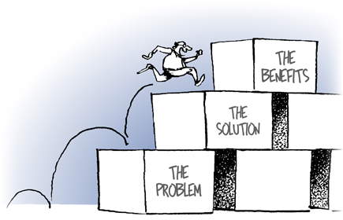
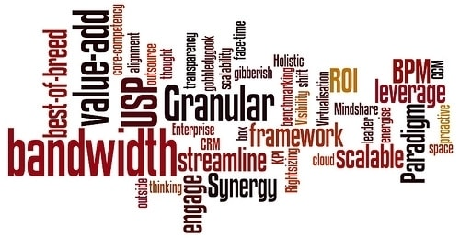
Composition (15 points)
Proposal flows logically. Writing style is direct and action-oriented (0-5 points)
Proposal is suitable for a general academic audience. Technical terms are defined (0-5 points)
Proposal shows evidence of proofreading, with few errors in grammar or usage (0-5 points)
19
Notes:
The goal of a proposal is to gain support for your plan by informing the appropriate people. Your ideas or suggestions are more likely to be approved if you can communicate them in a clear, concise, engaging manner. You writing style should be direct and action oriented.
Keep in mind of your audience while writing the proposal.
Avoid the technical terms but if you need to use technical terms, define them properly.

Slide 20
Budget (30 points)
Applicant pursued other sources of funding within the University or academic community (e.g. department, Office of Graduate Studies, Career Services), or from outside organizations relevant to the applicant’s research (0 OR 10 points)
Budget has been completed using the GPSA Budget template and items to be funded by SRG/PDG, applicant, or other sources are indicated as such (0 OR 5 points)
Budget appears well-researched and complete for scope of project (names of facilities, dates, itineraries, etc.), listing all spending related to activity. Choices appear to be economical and/or are explained (0-15 points)
20
Notes:
Make sure your proposal makes sense financially:
Mention all the sources of funding you have requested or applied, and the amount requested within the University or academic community (e.g. department, Office of Graduate Studies, Career Services), or from outside organizations relevant to the applicant’s research.
Follow the GPSA budget template to complete the budget. Itemize all the items that are funded by PDG/SRG and other sources of funding.
Research and list all the spending activity during your project. Your budget should be well researched and complete and should be within the scope of project. Being as meticulous as possible will give your readers confidence that you've done your homework and won't waste their money.

Slide 21
Score sheet for Professional Development Grant
Notes:
Understanding the score sheet used to evaluate grants is crucial to writing an effective proposal. Readers will score your grant based on this rubric; therefore, it is recommended to address all the points mentioned in the rubric so as to increase your chances of being awarded the grant that you applied for.

Slide 22
Scoresheet overview
Background (20 points)
Benefits (40 points)
Composition (10 points)
Budget (30 points)
750 WORDS MAX!
22
Notes:
PDG is also graded in the same manner as SRG is graded but there is a difference in score weighting in each heading.

Slide 23
Background (20 points)
Applicant’s academic/professional interests are clearly stated (0 or 5 points)
I hope to forge lasting professional connections that will serve me immediately as I complete my dissertation at UNM, and in the future as I apply for postdoctoral positions
Applicant’s professional goals are clearly stated (0 or 5 points)
The reason I want to do this is twofold; first, I want to employ data analysis techniques in my dissertation which my committee at UNM do not specialize in, and second, I am hoping to increase the interdisciplinary appeal of my research by collaborating with researchers who specialize in other fields.
What exactly will the applicant do? (0-5 points)
On Friday I will have three 20-minute reviews with professionals in the fine art community. I will meet with curators and working artists and gain feedback to push my work forward.
Where and when is the activity happening? (0-5 points)
A perfect opportunity to make connections with potential collaborators will be the Human Biology Council’s annual meeting this April in Calgary, Alberta, Canada.
23
Notes:
On background section, applications will be graded based on:
Your academic or professional interests must be clearly stated. Share your passion and interests that drives you to this conference/workshop or training. State what the event/ activity is offering to you that you are so interested about
State your professional goals and what you want to learn from this particular event.
State what your roles will be in that event? What are you going to do in that event?
State about the event where and when is it happening?

Slide 24
Benefits (40 points)
Specific benefit(s) is clearly stated and explained (0-10 points)
Specifically, this conference will allow me to network with Dr. Szathmary of the University of Manitoba as well as other scientists studying in related fields to my own research.
Proposed activity’s benefits to applicant are clearly linked to professional development and/or career goals (0-15 points)
By attending the seminars for educators, I will learn from others what approaches are successful in the classroom and I can integrate that into my own classroom at UNM.
Activity put into context (0-5 points)
How is it significant for applicant goals? (0-10 points)
Additionally, as a first-time attendee at a professional conference, I gained practical knowledge of preparing for and participating in a conference, observing best practices in presenting professional work so that I can do this in the near future.
24
Notes:
On Benefit section, applications will be graded based on following information provided:
State what specific benefits or opportunities you are going to get from this event.
State how the proposed activity’s benefits are going to help you in your professional development and how they are linked.
Give more information about the activity/events and what it is offering
Describe how it is helpful for your goals?

Slide 25
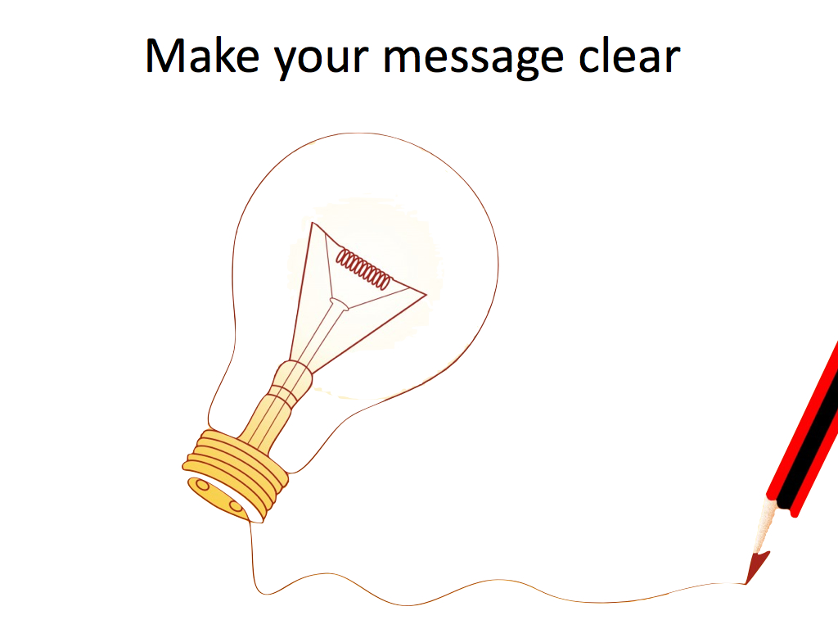
Composition (10 points)
Proposal flows logically and writing is clear. (0-5 points)
Proposal is suitable for a general academic audience. Technical terms are defined. (0-5 points)
25
Notes:
As I said earlier, Proposal should flow logically. Writing should be clear and action oriented. Keep in mind of your audience while writing the proposal.
Avoid the technical terms but if you need to use technical terms, define them properly.

Slide 26
Budget (30 points)
Applicant pursued other sources of funding within the University or academic community (e.g. department, Office of Graduate Studies, Career Services), or from outside organizations relevant to the applicant’s research (0 OR 10 points)
Budget has been completed using the GPSA Budget template and items to be funded by SRG/PDG, applicant, or other sources are indicated as such (0 OR 5 points)
Budget appears well-researched and complete for scope of project (names of facilities, dates, itineraries, etc.), listing all spending related to activity. Choices appear to be economical and/or are explained (0-15 points)
26
Notes:
Mention all the sources of funding you have requested or applied, and the amount requested within the University or academic community (e.g. department, Office of Graduate Studies, Career Services), or from outside organizations relevant to the applicant’s research.
Follow the GPSA budget template to complete the budget. Itemize all the items that are funded by PDG/SRG and other sources of funding.
Research and list all the spending activity during your project. Your budget should be well researched and complete and should be within the scope of project. Being as meticulous as possible will give your readers confidence that you've done your homework and won't waste their money.

Slide 27
Budget Template
Additional Budget Details (OPTIONAL): Space to write out any details that wouldn’t fit in the template. DO NOT EXCEED 300 words.
Item – Flight, registration, etc.
Description – details about the item including the source of information
Amount requested from GPSA Professional Development Grant – The Dollar amount for the line item you are requesting funds from GPSA
The sum of this column CANNOT EXCEED $500
27

Slide 28
Budget Template
Other sources of funding requested or obtained –
Mention any other resource (on or off campus) from where you have requested funding for each line item
Amount requested from other sources of funding – The dollar amount you have requested from mentioned resource. CAN EXCEED $500
Total cost = Amount requested from GPSA Professional Development Grant + Amount requested from other sources of funding. CAN EXCEED $500
28

Slide 29
Notes:
Here is an filled out budget template. You can take it as for your reference.

Slide 30
Score sheet for Graduate Scholarship Fund
Notes:
Understanding the score sheet used to evaluate grants is crucial to writing an effective proposal. Readers will score your grant based on this rubric; therefore, it is recommended to address all the points mentioned in the rubric so as to increase your chances of being awarded the grant that you applied for.

Slide 31
Scoresheet overview
Background (40 points)
Benefits (20 points)
Composition (20 points)
Letter of Recommendation (20 points)
500 WORDS MAX!
31
Notes:
For GSF, we have divided the 100 points into subheadings in which background constitutes 40 points, benefits 20 points, composition 20 points and Letter of Recommendation 20 points.

Slide 32
Background (40 points)
Interests are clearly stated (0-10 points)
Financial need described in detail (0-20 points)
Pursued other funding (0-10 points)
32
Notes:
Grant committee wants to know about you, your interests and your academic aspirations. State your interests clearly.
Explain how you are currently paying for college. Describe your financial situation. Tell if you are currently working to support yourself. Describe special family circumstances, such as whether you are the first-generation college student.
Describe other sources of support you are currently receiving, such as from your family or if you have pursued other sources of funding.
Purpose of funding – books, semester
Other sources of funding – amount and benefit

Slide 33
Benefits (20 points)
Helps to complete the degree
Explain the usage of the fund
33
Notes:
You need to be specific and realistic about what you can accomplish with this grant. Explain what this fund means to you in the process of earning a degree and how you are going to utilize it.

Slide 34
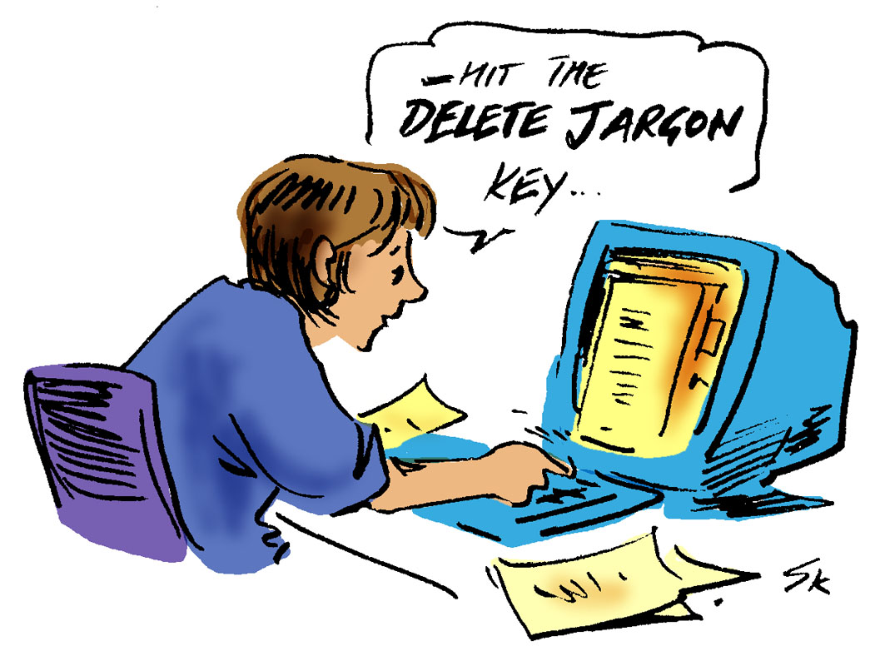
Composition (20 points)
Proposal flows logically and writing is clear. (0-10 points)
Proposal is suitable for a general academic audience. Technical terms are defined. (0-10 points)
34
Notes:
As I said earlier, applicant's proposal should flow logically. Writing should be clear and Action oriented. If they are defining the technical terms in used.

Slide 35
Letter of Recommendation (20 points)
Explains good academic standing and supports the financial need by a faculty member of UNM
35

Slide 36
Scoring for Graduate Scholarship Fund
40% of the total score will be based on your FAFSA that the Financial Aid Office will provide
60% of the total score will be based on the application that you submit
36

Slide 37
Score sheet for New Mexico Research Grant
General Priority

Slide 38
Scoresheet overview
Background (25 points)
Benefits (25 points)
Composition (10 points)
Budget (30 points)
Letter of Recommendation (10 points)
700 WORDS ONLY!

Slide 39
Background (25 points)
Research is described in detail (0-10 points)
What the applicant will do, when and where is the research happening, and why it is necessary for the applicant’s interests
Applicant’s academic or professional interests and stage in degree program are clearly stated and explicitly linked to the applicant’s current and future goals (0 or 5 points)
Research is put into the context of the applicant’s professional field at large (0-5 points)

Slide 40
Benefits (25 points)
Benefits of research to applicant’s are clearly stated and linked to applicant’s professional development (0-10 points)
Benefits to the University of New Mexico, academic community and the society are clearly stated (0-15 points)

Slide 41
Composition (10 points)
Writing style is direct, explicit and free of grammatical errors (0-5 points)
Proposal is suitable for general academic audience and technical terms are defined (0-5 points)

Slide 42
Budget (30 points)
Applicant pursued other legitimate sources of funding (0 or 5 points)
Sources of funding are shown for each line item in the budget (0 or 5 points)
Budget is well researched and complete for the scope of the project (names of facilities, itineraries, etc.) listing all spending related to activity (0-15 points)
Budget choices appear to be economical, and all high cost items are explained (0-5 points)

Slide 43
Letter of Recommendation (10 points)
Letter indicates support from faculty of the research project (0-10 points)

Slide 44
Score sheet for New Mexico Research Grant
High Priority

Slide 45
Scoresheet overview
Background (25 points)
Benefits (35 points)
Composition (10 points)
Budget (30 points)
Letter of Recommendation (20 points)
1100 WORDS ONLY!

Slide 46
Background (25 points)
Research is described in detail (0-10 points)
What the applicant will do, when and where is the research happening, and why it is necessary for the applicant’s interests
Applicant’s academic or professional interests and stage in degree program are clearly stated and explicitly linked to the applicant’s current and future goals (0-5 points)
Research is put into the context of the applicant’s professional field at large (0-5 points)

Slide 47
Benefits (35 points)
Benefits of research to applicant’s are clearly stated and linked to applicant’s professional development (0-10 points)
Benefits to the University of New Mexico, academic community and the society are clearly stated (0-15 points)
Benefits to New Mexican communities are clearly explained (0-10 points)

Slide 48
Composition (10 points)
Writing style is direct, explicit and free of grammatical errors (0-5 points)
Proposal is suitable for general academic audience and technical terms are defined (0-5 points)

Slide 49
Budget (30 points)
Applicant pursued other legitimate sources of funding (0 or 5 points)
Sources of funding are shown for each line item in the budget (0 or 5 points)
Budget is well researched and complete for the scope of the project (names of facilities, itineraries, etc.) listing all spending related to activity (0-15 points)
Budget choices appear to be economical, and all high cost items are explained (0-5 points)

Slide 50
Letter of Recommendation (20 points)
Letter indicates support from faculty of the research project (0-10 points)
Letter from New Mexico agency that articulates collaboration between applicant and state agency; state agency representative indicates support of the project (0-10 points)

Slide 51
Helpful tips
KNOW YOUR AUDIENCE:
Per the GPSA Bylaws, all grant submissions are scored by three other graduate students:
One from within your perspective
One from outside of your perspective
A third determined at random
51
Notes:
While writing the proposal, consider you audience. Because it helps you to gear your application - the language you use and the technical level of your explanation - to that particular audience.

Slide 52
Perspectives
Fine Arts & Design (FAD): Applies to any creative arts whose products are to be appreciated primarily or solely for their artistic, aesthetic or intellectual content. Examples: Studio Art, Music, Theatre, Dance, Film, Creative Production
Humanities (HUM): Applies to academic disciplines that study aspects of human society and culture, or process and document the human experience. Examples: Ancient and Modern Languages, Literature, Philosophy, Geography, History, Religion
Social Sciences (SOS): Applies to disciplines dealing with the institutions and functioning of human society, or with a particular phase or aspect of human society. Examples: Economics, Business, Management, Public Administration, Public Policy, Law, Political Science
Behavioral Sciences (BES): Applies to disciplines dealing primarily with human action, and often seeks to generalize about human behavior in society. Examples: Psychology, Sociology, Education, Anthropology, Women Studies, Communication.
Natural Sciences (NAS): Applies to sciences that deal with matter, energy, or the physical world, and their interrelations and transformations or with objectively measurable phenomena. Examples: Biology, Chemistry, Earth Sciences, Astronomy, Physics.
Formal Sciences (FOS): Applies to disciplines concerned with theoretical formal systems, and the theoretical branches of computer science. Examples: Computer Science, Math, Geometry, Statistics, Logic, Information Theory, Systems Theory, Linguistics.
Applied Sciences (APS): Applies to disciplines that apply scientific knowledge to practical problems. Examples: Medicine and Health Sciences, Engineering.
52
Notes:
So, all the programs offered by the UNM has been divided into 7 perspectives.

Slide 53
Helpful tips
Paint a clear picture of who you are and why you are seeking funding
Give specific, vivid details on why you are attending a conference
State why attending this conference is important
Avoid field-specific and technical jargon
53
Notes:
A grant proposal is a unique document and requires careful preparation, sensitivity to your audience and the ability to answer some key questions. Paint a clear picture of who you are and why you are applying for this particular grant. But don’t write your name in the proposal or you will be disqualified. As I said earlier, avoid using technical terms and if you have to use them, define them.

Slide 54
Helpful tips
Answer all of the scoresheet requirements:
Background
Benefits
Composition
Budget
Review and revise
Narrative flow
Grammar (when in doubt, check Purdue Owl at https://owl.english.purdue.edu/ or schedule a free appointment with a volunteer editor at the GRC - 505-277-1407)
54
Notes:
Make sure you review the scoring guideline while writing your statement of Proposal. Answer all the details regarding Background and Benefits. Make Sure your proposal is well composed. Writing is clear and flows logically. And make sure you use the GPSA budget template. You can download the budget template from award application portal too.
Always review and review your statement of proposal. The more you revise, the more refined will be your proposal. when in doubt regarding your grammar, take help from the online resources such as Purdue Owl or you can always schedule a free appointment with a volunteer editor at Graduate Resource Center

Slide 55
Helpful tips
Write for a general academic audience
Avoid jargon and define all terms
Make sure proposal is free of grammatical and spelling errors
Find someone to proofread (Seriously!)
Peer in department
Peer outside department
Peer who has received a grant
Graduate Resource Center (GRC)
55
Notes:
Know your audience. Keep your audience in mind while writing proposal
Avoid technical terms. And if you are using them, define them.
Make sure your proposal is free of grammatical and spelling errors.
You can take help some one may be to proofread
Lastly, when you are applying for two scholarships, make sure you have provided the documents.

Slide 56
Disqualification criteria
Failure to turn in an application by the deadline
Failure to turn in a complete application
Violation of any of the guidelines enumerated within this article of the GPSA Grants Bylaws
Any submission that is plagiarized or not the sole work of the applicant
Applications submitted jointly by more than one applicant
Applications that go over the maximum word limit
56
Notes:
While applying for the grant, please make sure you submit the complete application in time. No late submission will be submitted.
Your application will be disqualified if you violate any of the guidelines enumerated within this article of the GPSA Grants Bylaws.
If you are using other’s words, quote it.
Application submitted jointly by more than one applicant will be disqualified.
Remember that SRG and PDG have maximum word-limit of 750 words and GSF has maximum 500 words-limit.

Slide 57
Travel Guidelines (Covid 19)
While applying for the grants that requires you travel, consult with your department if there are any travel restrictions.
For more information on travel restricted locations, follow the CDC guidelines:
https://www.cdc.gov/coronavirus/2019-ncov/travelers/index.html
If you are approved for the travel funding but the workshop/event/seminar later changed to virtual, please report back to us. We want transparency from our awardees.
57

Slide 58
Questions ?
Email gpsafunding@unm.edu
PREFERED METHOD of communication
Grants Website: unmgpsagrants.awardspring.com
GPSA Website: gpsa.unm.edu (under funding tab)
GPSA office number: (505)-277-3803
In addition, this presentation will be uploaded to the GPSA website for your reference: http://gpsa.unm.edu
58

