Slide 1

Grant Applicant Information
SUmmer 2025

Slide 2
GPSA Grants Overview
Every Summer, Spring, and Fall semester GPSA offers several grant programs to GPSA-member graduate degree-seeking students .
The grants are made possible through a combination of interest from fund endowments, legislative appropriations, and GPSA student fees.

Slide 3
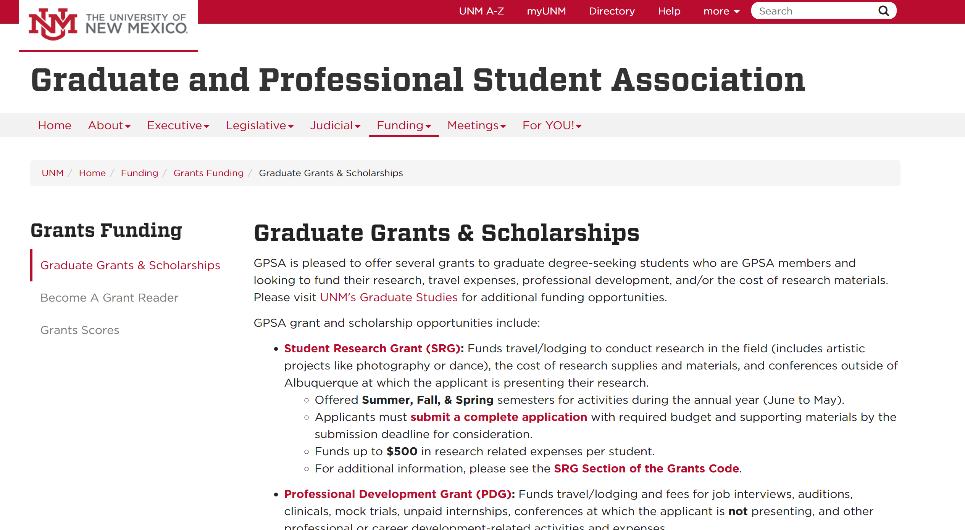
Website Information
The website is your jumping off point
Source of all information
Access to AwardSpring
Info Session Recordings
Grants Code Updates
  No GSF Support Letter
  Streamline all grants
https://gpsa.unm.edu/funding/grants-funding/grant-scholarship.html

Slide 4



AwardSpring Access
Revamped Application
https://unmgpsagrants.awardspring.com/

Slide 5
Grants and Scholarships
Student Research Grant
Professional Development Grant
Graduate Scholarship Fund
5

Slide 6

Student Research Grant (SRG)
Supports the development & dissemination of research or original work.
The SRG funds up to $750 per student per year. (If you receive an SRG grant in the Summer or Fall 2025 you are ineligible the spring 2025).
Research activities must occur or have occurred between Jun. 1, 2025 and May 31, 2026.
6

Slide 7
SRG Priorities
Activities funded:
  Any research-related expenses, broadly defined to encompass fine arts and musical compositions, legal research, etc.
  Airfare, registration, hotel, shuttle fees, taxi fare, presentation materials, food for conference at which you are presenting. (Must be outside of ABQ)
  Supplies, consumables and printing costs
    Equipment you might need for data collection
    e.g, camera for recording sessions
7

Slide 8
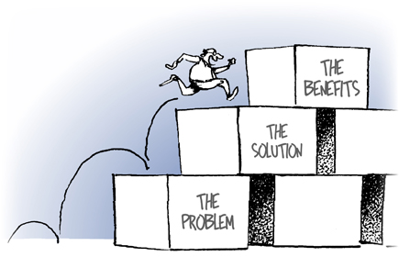
SRG Scoring Criteria
Background (25 points)
  Academic/professional interests and stage in degree
  Describe the activity (what, where, when) and its significance
  Connect activity to broader academic field.
Benefits (30 points)
  Activity’s benefit to applicant, linked to professional interests.
  Benefit of applicant’s work to the academic community.
500-600 WORDS MAX
8

Slide 9
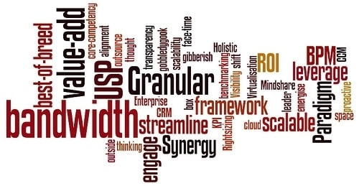
SRG Scoring cont’d
Composition (15 points)
  Flows logically, direct writing style, defined technical terms, and proofread.
Budget (30 points)
  Completed budget template
    Well-researched and reasonable
    Documentation to verify costs
9

Slide 10

Professional Development Grant (PDG)
The PDG funds up to $600 per student
Events/activities occurring between June 1, 2025 and May 31, 2026.
Expenses that further the professional and career development of students:
  Conferences – CANNOT BE PRESENTING
  Workshops & Trainings
  Interviews & Auditions
  Mock trials
Airfare, registration, hotel, shuttle fees, taxi fare, professional membership fees.
  Travel must be outside of Albuquerque
10

Slide 11
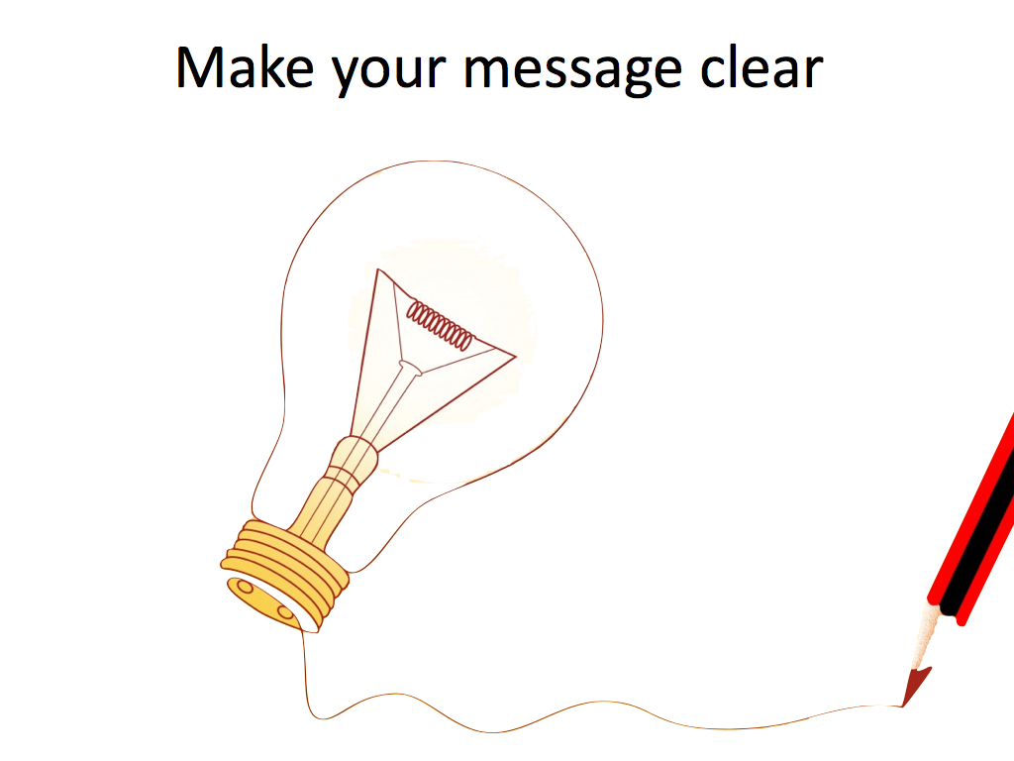
PDG Scoring
Background (20 points) plus goals
Benefits (40 points) plus significance to your goals
Composition (10 points)
Budget (30 points)
500 - 600 WORDS MAX
11

Slide 12
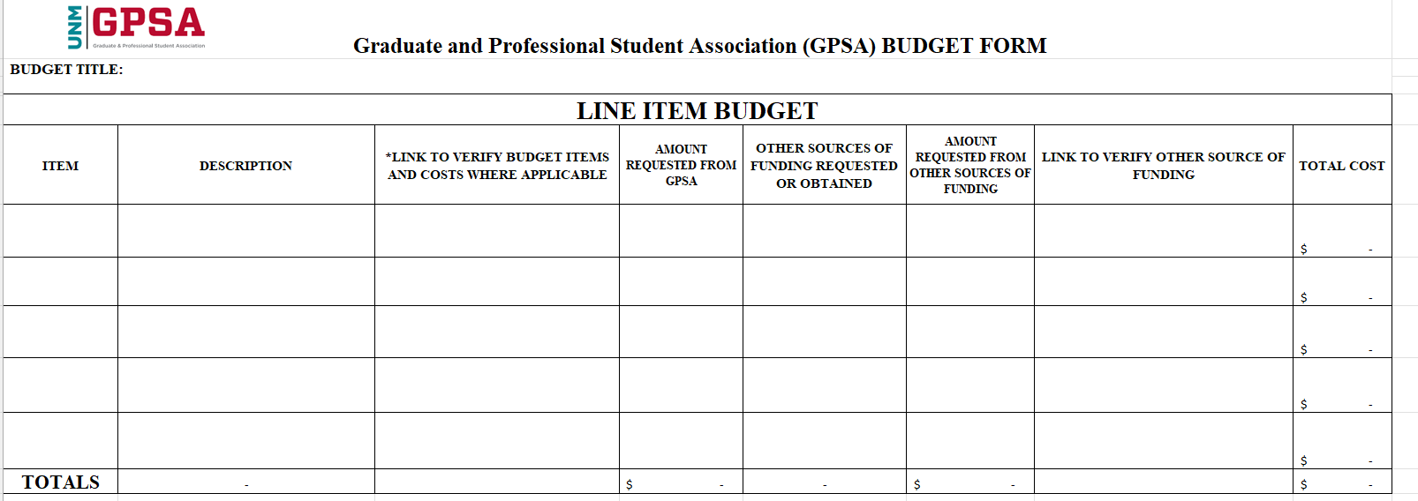
SRG & PDG Budget
Additional Budget Details (OPTIONAL): Space to write out any details that wouldn’t fit in the template. DO NOT EXCEED 300 words.
Please fill out ALL of the columns for each line item
Item - Mention the item for which you are requesting money. Examples include airfare, registration.
Description - Describe the item, including the source of information for the amount. For example, if the flight ticket costs $200, mention where you obtained that information from (airfare.com). Please provide evidence of this item where applicable.
Link to verify budget items and costs where applicable - Provide supporting evidences of the items listed.
12
Notes:
Make sure your proposal makes sense financially and BE SPECIFIC:
Follow the GPSA budget template to complete the budget – and make sure it is complete with supporting documentation. Itemize all the items that are funded PDG/SRG and other sources of funding.
Please also note all the sources of funding you have requested or applied for, and the amount requested – whether within the University or academic community or from outside organizations. It is ok to let us know if you tried but did not get funding. This does not factor into scoring but does help ensure you are not double-dipping.
Ensure that your links work and take us to valid sites for verification. This is very important. We cannot award funding if we cannot verify your budget request.
Research and list all the spending activity during your project. Your budget should be well researched and complete and should be within the scope of project. Being as meticulous as possible will give your readers confidence that you've done your homework and won't waste their money.

Slide 13
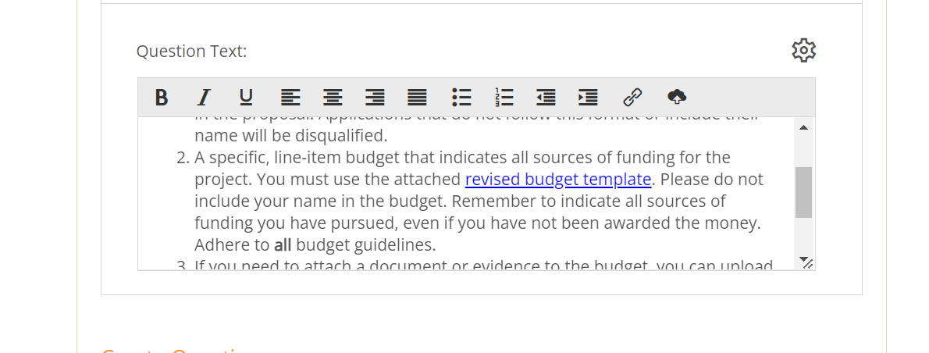
Budget cont’d
Amount Requested from GPSA - The dollar amount you are requesting from the GPSA towards that line item.
Other Sources of Funding requested or obtained - Mention any other resource (on or off campus) where you have requested or obtained funding for each line item. Out-of-pocket expenses are allowed ONLY when other sources of funding are declined or not applicable.
Amount Requested from other sources of funding - The dollar amount you have requested from another resource.
Evidence of other sources of funding - Provide evidences of these sources where applicable. These could be links to screenshots, google docs, etc.
13
Notes:
The budget template can be found at the end of the instructions in the application template, once you are in AwardSpring:
You must use the attached revised budget template. When you click on the "revised budget template" it takes you to what you need to fill. Save and then upload the completed template to your application.

Slide 14
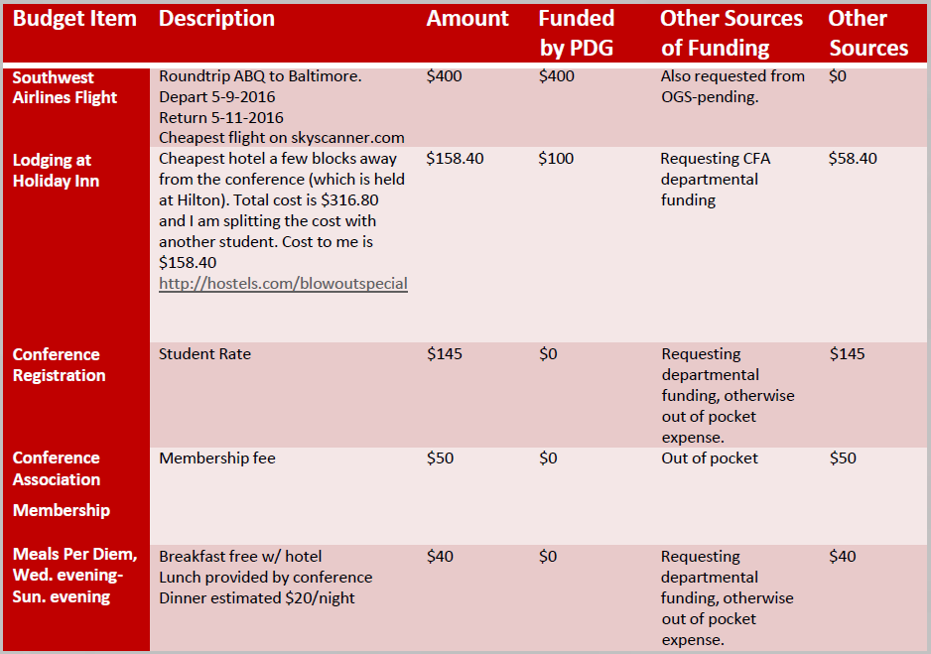

Slide 15
Graduate Scholarship Fund (GSF)
The GSF can help offset up to $1000 in educations expenses for the summer semester only.
MUST be enrolled in at least 6 credit hours in the Summer semester
Helps offset tuition, books, or fees
Demonstrated financial need based on info from Financial Aid
  International students must complete an online State-Aid application for the current academic year (2025-2026).
  Resident students must have submitted FAFSA for this academic year (2025-2026).
15

Slide 16

GSF Application Scoring
60% of the overall score comes from the application; 40% of the score is from financial info provided by the Financial Aid Office
Scoring
Background (30 points)
  Interest stated, Financial needs, Pursued other funding
Benefits (20 points)
  Explain usage of fund – degree completion.
Composition (10 points)
  Flows logically, technical terms defined.
Financial Aid Office data (40 points)
500 WORDS MAX
16

Slide 17
Scoring for Graduate Scholarship Fund
40% of the total score will be based on financial info from your FAFSA or State Aid Form that the Financial Aid Office will provide
60% of the total score will be based on the application that you submit
17

Slide 18
Applicant Eligibility Review
Must be a degree-seeking GPSA member graduate student currently enrolled in in courses
  GSF: Must be enrolled in at least 6 credit hours
  Competitive grants for individuals only, not groups
Requesting funding for events or activities occurring between June 1, 2025 & May 31, 2026
  GSF: Can only support current semester need
  HSC: Clinical rotations anytime between June 2025 & May 2026
Agree to use funds only for the purpose described in the application, if funded.
18

Slide 19
Disqualification criteria
Failure to turn in complete, original application by the deadline
Failure to be enrolled in required number of credit hours
Violation of any of the guidelines enumerated within the Grants Code section of the GPSA Bylaws and the AwardSpring application
Requesting funds for activities that fall outside the grant cycle dates
Applications submitted jointly by more than one applicant
Failure to submit an anonymous proposal (DO NOT include your name in the application narrative or budget materials)
19

Slide 20
Total No. of Awards
GSF (Graduate Student Fund):
Fall/Spring: up to 25 awards
Summer: up to 8 awards
SRG (Student Research Grant):
Fall/Spring: up to 35 awards (including up to 7 appeals)
Summer: up to 15 awards (including 1–3 appeals)
PDG (Professional Development Grant):
Fall/Spring: up to 35 awards (including up to 7 appeals)
Summer: up to 15 awards (including up to 3 appeals
20

Slide 21

Deadlines & Other Info
Deadline for submission: Friday, Jul. 4, 2025, 5:00 PM MST
  Late applications WILL NOT be accepted
  DO NOT WAIT until the last minute
All applications must be submitted online at: unmgpsagrants.awardspring.com
Appeals are overseen by the Grants Committee and must occur within 14 calendar days of decision notifications
International students may have tax withheld by the Scholarship or Financial Aid Office. Reach out to FAO with questions.
21

Slide 22
Further Assistance
GPSA Grants Troubleshooting Workshop
    Friday, Jul 4, 11am-1pm @ zoom meeting, link on the GPSA website
    Assistance with AwardSpring access, technical issues, questions about proposals and scoring criteria
Center for Teaching & Learning - https://ctl.unm.edu/
    Workshops, writing assistance, many other useful resources
Office of Graduate Studies - https://grad.unm.edu/home/
    Great resource for other funding opportunities
22

Slide 23
Looking Ahead…
GPSA ByLaw Amendments
  Workshop requirement within the year (at least one) in June 1, 2025 to May 31, 2026

Slide 24

Questions ?
Email gpsafunding@unm.edu
GPSA Website: https://gpsa.unm.edu/funding/grants-funding/grant-scholarship.html
Grant Submission Portal: unmgpsagrants.awardspring.com
Technical Assistance? If you need help troubleshooting issues, applications questions, or would like further assistance visit the Zoom Assistance, Friday, . 4, 11 am to 1pm.
The Info Session presentation will be uploaded to the GPSA website for your reference: https://gpsa.unm.edu/funding/grants-funding/grant-scholarship.html
24

