Slide 1
Council Member Info Session
2021-2022

Slide 2
Mission
To enhance the academic and intellectual environment for the graduate and professional students at the University of New Mexico and to promote the rights, interests and professional development of graduate and professional students within the university community, through advocacy, education, and financial support.
Notes:
GPSA has been the recognized Graduate and Professional Student Government at the University of New Mexico since 1969.
Our missions is To enhance the academic and intellectual environment for the graduate and professional students at the University of New Mexico and to promote the rights, interests and professional development of graduate and professional students within the university community, through advocacy, education, and financial support.

Slide 3
Involvement
Offer numerous grant funding opportunities to graduate and professional students for research, travel, and presentation of their work at conferences.
Provide funding to student organizations through appropriations and annual budget. As well as Provide funding to recognized departmental student association (RDSA) trough pro-rated benefits (PB) funds.
Represent
Represent graduate and professional students on numerous University and Faculty Senate committees and before the Board of Regents.
Represent
Represent the interests of graduate and professional students on the Student Fee Review Board (SFRB). Providing students with the opportunity to represent their departments on the GPSA Council.
Lobby
Send GPSA representatives to the New Mexico State Legislature to lobby for graduate and professional students' interests via Capital Outlay Projects.
Network
Network with the National Association of Graduate and Professional Students (NAGPS).
Resource
Provide resources to graduate and professional students.
Funding
Grants
Notes:
Some of the ways the GPSA stays involved

Slide 4
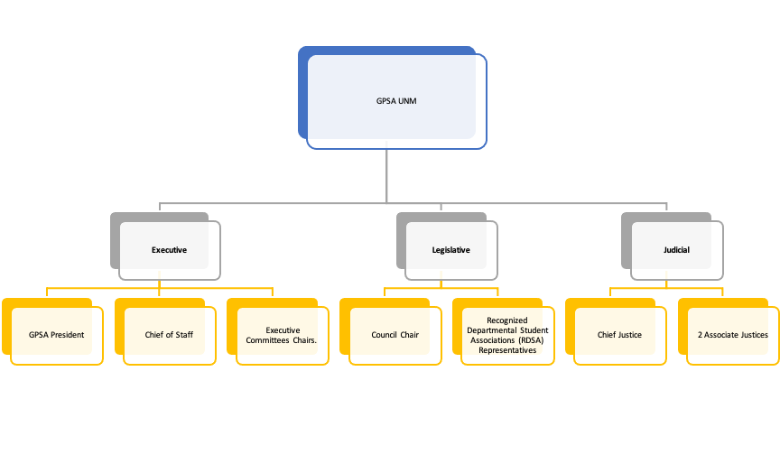
Committee Chairs
Notes:
GPSAs organizations chart
Executive: Made up of the GPSA President, Chief of Staff and Committee Chairs. The Executive serves as the official representative of GPSA to the Board of Regents and the public.
Legislative: Consists of the Council Chair and Recognized Departmental Student Associations (RDSA) Representatives. Council represents a broad spectrum of student interests across campus.
Judicial: Made up of the Chief Justice and two Associate Justices, the Court of handles internal GPSA disputes.

Slide 5
GPSA Council Representative
As per the GPSA Constitution (Article III, Section 1, A.2) for every 100 enrolled students (or portion of 100) each department/ recognized departmental student association (RDSA) is entitled to one Representative.
RDSA select their own Council Representative(s).
RDSA must submit a credential form each year to the GPSA Council Chair.
GPSA Council Representative(s) must attend monthly meetings.
Update their department on GPSA functions, deadlines and news
GPSA Council Representatives act as the voice of their departments on the GPSA Council.
Notes:
To the 1st point PB Funds are also awarded based on the number of students enrolled in your department. These funds are dispersed by the student government accounting office.

Slide 6
Join! GPSA STANDING COMMITTEES
Grants: gspafunding@unm.edu Administers the Student Research Grant (SRG), the Professional Development Grant (PDG), and the New Mexico Research Grant (NMRG).
Finance Committee: gpsafin@unm.edu Assists with preparation of the GPSA annual budget, and allocates money to graduate & professional student organizations through the appropriations process.
Elections: gpsaelec@unm.edu Prepares for and oversees the GPSA General Election, Council Chair Election, and Departmental elections (upon request).
Lobby: gpsalobb@unm.edu Brings graduate and professional student concerns before the New Mexico State Legislature.
Programs: gpsaprograms@unm.edu Implements programs that serve and facilitate interaction between graduate & professional students at the University of New Mexico, and provide service to the University and local community.
Student Support & Advocacy (SS+A): gpsasupport@unm.edu Advocates for graduate & professional students and identifies campus and community resources for students.
Ad-hoc - Communication: gpsamedia@unm.edu Further GPSA's goals through effective communication strategies and skills, internally and externally.
Lesgislative Steering Committee (LSC): gpsalsc@unm.edu
Composed of Council Representatives. Reviews non-appropriative legislative items, such as Resolutions and Amendments to the Constitution or Bylaws, and to make recommendations on those items for Council’s consideration.
Notes:
As GPSA and Council members you can join these committees.
FC and LSC members have to be confirmed
FC Chair and 2 member appointed by GPSA President, FC Vice-chair and 2 member appointed by GPSA Council Chair
LSC members can only be council members (min 5 max12 members)

Slide 7
Navigate http://gpsa.unm.edu/
Meet the 2021-2022 team
GPSA Constitution and Bylaws
Access Council information and documents
Other information
Notes:
GPSA website where you can access information pertaining GPSA and specifically council

Slide 8
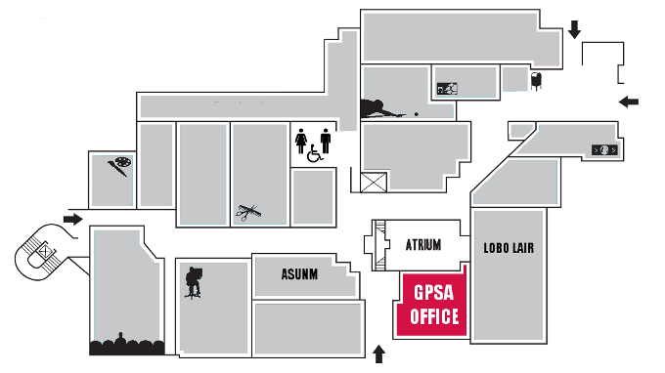
Notes:
Due to Covid the office is operating at limited hours.
Office manager Victoria
Can volunteer and set own schedule
Offer coffee
Computer lab

Slide 9
Questions

Slide 10
Council meeting Parliamentary Procedures

Slide 11
Council Basics
Requests for being added to the meeting agenda must be submitted to Council chair by 10 a.m. on the Tuesday proceeding the scheduled meeting.
The parliamentary authority of the GPSA Council’s 2021-2022 session will be the most recent edition of Robert’s Rules of Order Newly Revised.
For comments not related to the meeting agenda, a speaker is allotted one speaking period of three minutes during the public speaking section of the agenda.
Public Notice of scheduled Council meeting and the agenda will be sent out and accessible on the GPSA website in accordance to the Open Meetings Act (OMA).

Slide 12
Council Basics Cont.…
6 RDSA’s must be represented at every Council meeting to meet quorum
Each member is able to speak twice on a motion for up to three minutes each
Only one person should be talking at once
There will only be one question or motion considered at once
When closing your statements you should conclude with “I yield” to avoid confusion or overlap between speakers
If you have a question relating to what is being discussed you can say “point of information”. If you need to be excuse or have other questions you can say “point of personal privilege”. You can say these at anytime.

Slide 13
Procedure for Handling Main Motion
Address
Member will address chair and make motion
Ask
Chair will ask for second
Second
Another member will second
If there is no second the motion fails
Vote
Voice vote will be taken and motion will move forward or fail
Have questions regarding motion on floor
Discussions
Questions
Have discussions regarding motion on floor
Notes:
“Madam Chair, I’d like to move to open Appropriation 1F”
“Do I hear a second?”
“I second” – another Council member
“Seeing no second, that motion has failed”
“It was moved by X member to open Appropriation 1F and seconded by Y member, all those in favor please say aye, opposed, abstain, that motion has passed/failed”
“this brings us to questions, do I hear any questions”
Chair will call on members as they raise their hands via Zoom
“this brings us to discussion, do I hear any discussion”
Chair will call on members as they raise their hands via Zoom
Members are limited to the number of

Slide 14
Types of Votes
Roll call Vote
Voice Vote
Used for motions that did not require a lot of debate
Is recommended for all final votes on legislation and appropriations to maintain good record in the minutes
Is used after there has been substantial discussion on the motion or legislation
Notes:
Yay nay abstention
You should exercise your right to vote. So abstain if it is a conflict of interest or if you were not present during questions and discussions.

Slide 15
Motion Made
Must be moved, seconded, and approved to move forward
Questions
Reserved for questions, opinions must be saved for discussion
Discussion
You have two speaking points
Vote
Amendments can be proposed, in which this process will repeat itself
Majority vote is required
Abstentions do not count towards overall vote count

Slide 16
Questions

